Slide 1
A Simple Online Inventory
I Really Like:
Gifted2Serve Gifts Inventory
http://buildingchurch.net/

Slide 2
Gifted to Serve
(Spiritual Gifts Inventory)
http://buildingchurch.net/
Click the “Gifted2Serve” Button on the Left

Slide 3
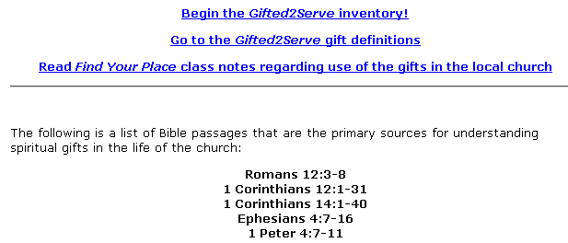
Click: Begin the Gifted2Serve Inventory
BTW – There are some very good definitions of the Gifts Also. BUT, I suggested you take the Inventory FIRST then Look at the Definitions.

Slide 4
At the BOTTOM of this page you’ll See This:

Slide 5
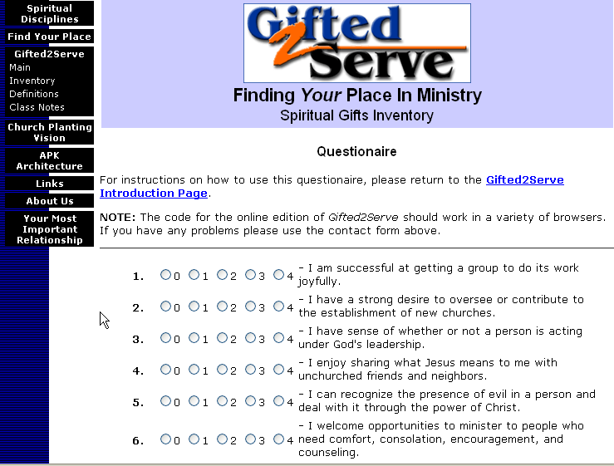

Slide 6
